Slide 2
General Information and Reminders
This is Non-Mandatory Pre-Submittal Meeting
Attendees should sign-in via chat on WebEx
Presentation will be posted on SAWS website along with the sign in sheet
Stay muted during presentation, questions may be entered in chat and will be addressed at the end

Slide 3
Oral Statements
Oral statements or discussion during this Pre-Submittal Meeting will not be binding, nor will they change or affect the RFQ or the terms or conditions of the contract. Changes, if any will be addressed in writing only via an Addendum

Slide 4
Agenda
Objective
Selection Process
RFQ Schedule
Evaluation Criteria
SMWB Requirements
Solicitation Page
Vendor Registration
Submission Requirements
Submission Deadline
Communication Reminders
Questions/Addendum
Project Overview
Questions

Slide 5
Objective
San Antonio Water System is accepting Statements of Qualifications from interested firms to provide engineering services, which will include the rehabilitation, replacement and installation of small pipe diameter water and wastewater infrastructure for unspecified projects which will require a Scope of Services to be performed by a qualified consultant(s) or consulting firm(s) on a work order basis.

Slide 6
Selection Process
SOQs reviewed for responsiveness
Technical Evaluation Committee scores qualification statements based on evaluation criteria published in the RFQ
Interviews held, if necessary
Selection Committee reviews scores and recommends firms
Good Faith Effort Plan will be evaluated and scored
Negotiation with selected consultants
Anticipated Board Award – July 2024

Slide 7
Selection Process
If there is a change to key team members (prime or sub-consultant) identified on Respondent’s organizational chart, notify SAWS in writing as soon as possible
  SAWS may allow Respondent to replace the key team member with an alternate member who possesses equal or better qualifications and experience
Per SAWS’ Ethics Policy, a former SAWS employee may not serve in a lead role as a key team member and/or participate in the negotiation of a contract for two (2) years after separating from SAWS
  Failure to adhere may result in the Respondent’s proposal being found non-responsive or a reduction in points during the technical scoring of the proposal

Slide 8
RFQ Solicitation Schedule
MILESTONE | DATE / TIME
Questions Due | February 12, 2024 @ 4:00 PM CST
Answers Posted | February 16, 2024 @ 4:00 PM CST
Submittals Due | February 27, 2024 @ 2:00 PM CST
Interviews (if necessary) | April 2024
Notification of Award / Contract Negotiations | May 2024
Board Award | July 2, 2024
Start Work | July 2024
** The dates listed above are subject to change without notice.

Slide 9
Evaluation Criteria
Criteria | Max Points
Team Experience and Qualifications | 20
Similar Projects and Past Performance | 25
Work Order Approach | 30
Quality Management/Quality Control Plan | 10
Small, Minority, and Woman-owned (SMWB) Business Participation | 15
Total | 100

Slide 10
Team Experience and Qualifications (20 pts)
Organizational Chart – Identify all proposed “Key Personnel” and “Key Sub-consultants”
  Percentage of time each key team member will be committed to the project and their corresponding role.
  Ensure sub-consultants match those listed on the Good Faith Effort Plan
  One (1) page limit
2) Provide resumes for the following personnel: Project Manager, Cost Estimator, Quality Assurance and Quality Control Leader and Reviewers, Design Team Leader(s)
  The Project Manager’s resume should be included first
  Identify three (3) similar projects and provide a detailed description of capabilities and project experience and role in project relevant to the Scope of Services requested within this RFQ
  List of all active projects the team member is currently assigned to for the duration of the Project include the phase and percentage of time allocated to each of the other projects.
  Eight (8) page limit

Slide 11
Team Experience and Qualifications (cont.)
3) Utilize the Sub-Consultant table (Fillable Form - Attachment II)
  Describe your firm’s most relevant experience, as well as the Respondent’ subconsultants role in performing work as it relates to the Scope of Services identified within this RFQ.

Slide 12
Similar Projects and Past Performance (25 pts)
  1) Utilize the Evaluation Criteria Forms: Similar Projects and Past Performance
  ( Fillable Form- Attachment III)
  Identify five (5) relevant projects, of similar size and scope to the Scope of Services & Additional Requirements identified within this RFQ that were completed within the past five (5) years.
  Identify key personnel, who are part of the proposed team, and their roles and responsibilities for at least three (3) of the five (5) projects.
  A minimum of three (3) of the projects identified were performed by Respondent
  Ensure contact information for references is correct and up to date
  2) Utilize the Opinion of Probable Construction Cost (OPCC) Table (Fillable Form- Attachment IV)
  Provide information for the three (3) completed projects submitted in Section 1, as well as three (3) additional projects, as it relates to the accuracy of the Opinions of Probable Construction Cost (OPCC) and change orders, comparing the 100% design phase estimate to approved construction awards

Slide 13
Work Order Approach (30 pts)
Provide a detailed narrative to describe the team’s approach to quickly understand the scope and complete the work orders, to include managing risk between design related issues, coordination with other governmental/non-governmental agencies and constructability as well as maintaining the schedule and overall project budget.
Identify Respondent’s team’s suggested alternative innovative approaches to accomplishing the scope of services identified within this RFQ that would result in a more successful and timely completion of the Work Order
Describe Respondent’s team’s approach to preparing deliverables to meet deadlines associated with fast-track schedules without compromise to quality. Include schedule risks and mitigation measures, schedule recovery approach and other issues relative to schedule maintenance on similar projects
  Six (6) Page Narrative Limit
  Responses to this criteria should clearly demonstrate Respondent’s familiarity with the Scope of Services identified within this RFQ

Slide 14
Quality Management/Quality Control Plan (10 pts)
Provide a specific and unique QA/QC plan for this project
  Overview of the QCP process for this project, the independent technical review team and their roles
  Plan for how design issues will be identified, tracked and resolved.
  How the independent quality review team will confirm design documents will result in project that is biddable, constructible, operable, maintainable, permittable and cost effective.
  QCP schedule
  Respondent’s role compared to SAWS’ role
  Approach to becoming familiar with local construction practices and requirements, standard products and material costs, local and regional market conditions, and the conditions (i.e. environmental, regulatory, etc.) influencing design and construction decisions for each project
  How the accuracy and completeness of independent cost estimates are derived for each of the design phase of the project
  Two (2) page narrative limit

Slide 15
Small, Minority, and Woman-Owned Business (SMWB) Participation (15 pts)
Scoring Method: 15 Points (by percentage) for meeting or exceeding the stated mandatory SMWB goal.
Not meeting the mandatory goal = 0 SMWB Points. Points awarded on an all-or-nothing basis.
If the goal is not met, proof of outreach to SMWBs must be provided. If proof of outreach is not provided, disqualification may occur.
Methods of outreach prescribed in the solicitation
25% Mandatory Goal

Slide 16
SMWB Requirements
All firms in the organizational chart must also be listed in the Good Faith Effort Plan.
Local-area office in one of the following counties: Bexar, Comal, Guadalupe, Hays, Kendall, Travis, or Williamson.
Must be “SBE” (including MBEs and WBEs), and need to be certified through the SCTRCA or Texas HUB.
Post-award, use of the S.P.U.R. System will be contractually required to report payments to all subconsultants, both SMWB and Non-SMWB.

Slide 17
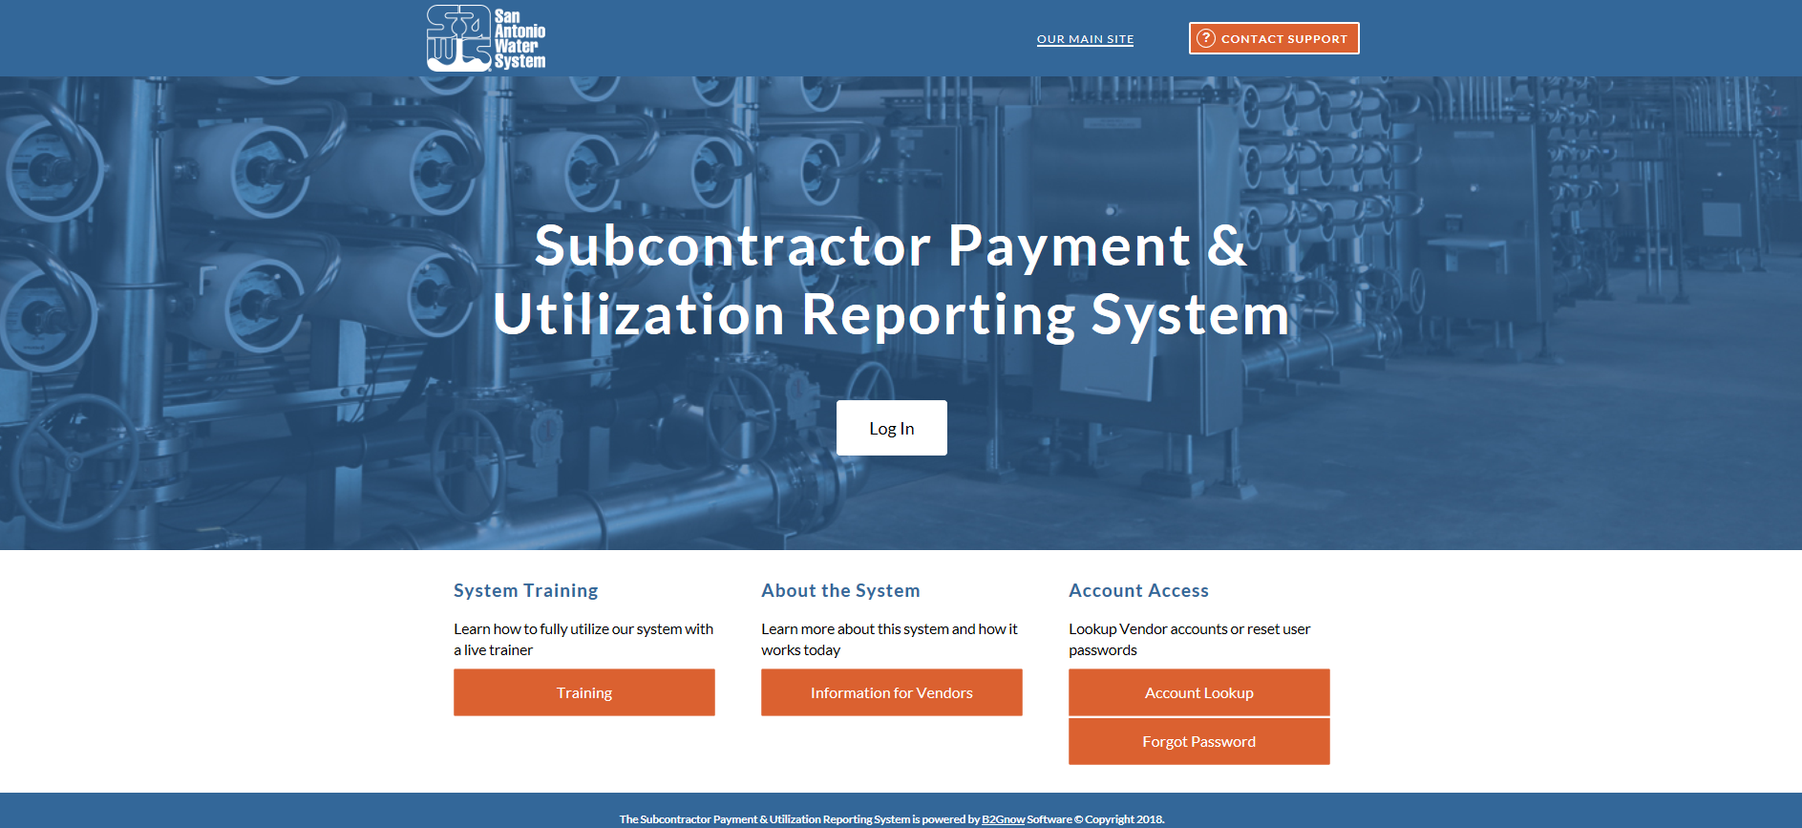
Post Award: Subcontractor Payment & Utilization Reporting (S.P.U.R.) System
www.SAWS.SMWBE.com

Slide 18
SMWB Questions
Questions related to the SMWB Program, the Good Faith Effort Plan (GFEP), or finding certified subconsultants may be directed to the SMWB Program Manager until the RFQ is due.
Marisol V. Robles
SMWB Program Manager
Email: Marisol.Robles@saws.org
Telephone: 210-233-3420

Slide 19
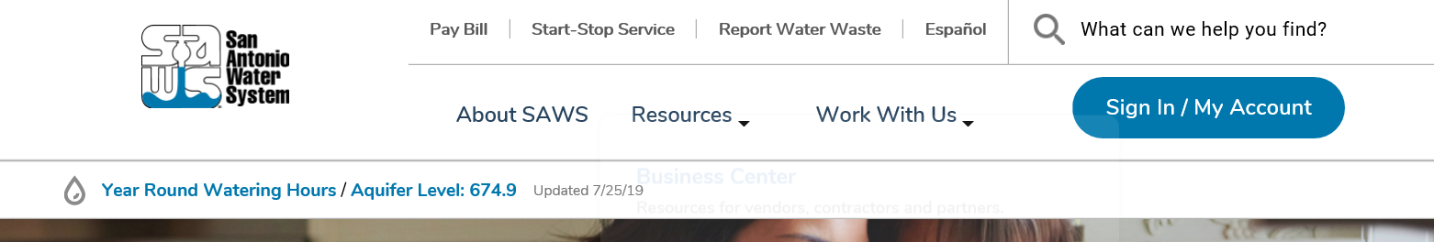
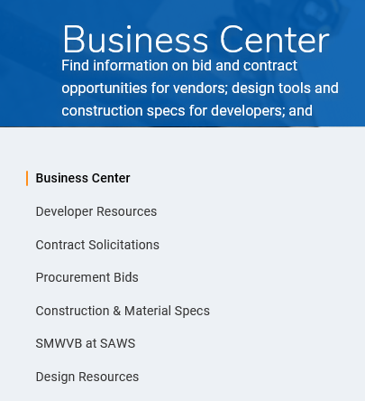
Contract Solicitations Website
To locate the Contract Solicitations website, choose Resources
Click on Business Center
At the drop-down menu choose Contract Solicitations

Slide 20
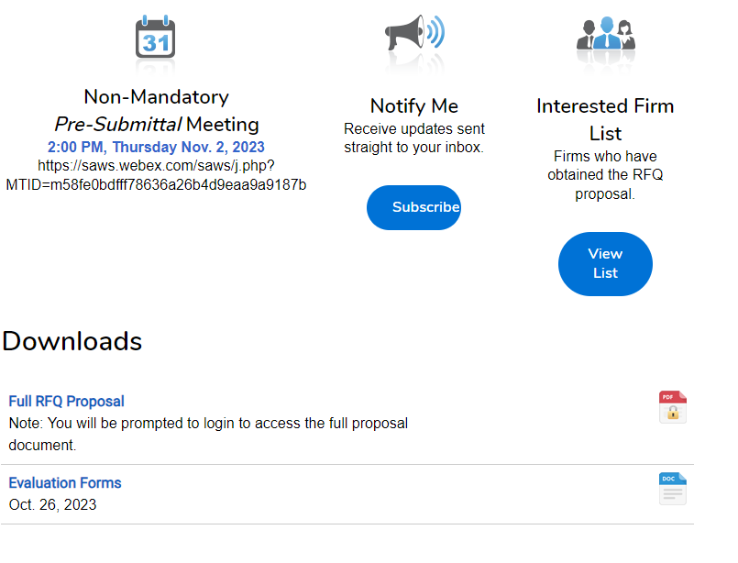
Contract Solicitations Website
Choose the specific project
The following buttons are now located under the advertisement:
  Notify Me
  Interested Firm List
  Downloads
    Full RFQ
    Evaluation Forms
    Addendums

Slide 21
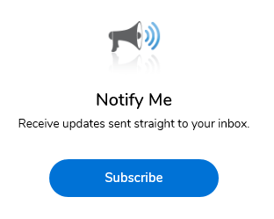
Vendor Registration & Notification (VRN)
Please register through SAWS Vendor Registration Program on the SAWS website at www.saws.org to ensure access to the latest information
To receive updates on specific projects, registered vendors must ‘Subscribe’ to the project by selecting the project and clicking ‘Subscribe’ under the Notify Me box
https://apps.saws.org/Business_Center/Contractsol/

Slide 22
Addenda
More than one (1) addendum may be posted
Addendums are acknowledged on the Respondent Questionnaire
Check SAWS website often and prior to submitting your proposal

Slide 23
Submission Requirements
File size limitation is 10 MB and shall be no greater than 17 pages
Use 8-½” x 11” portrait format (up to 11” x 17” will be permitted for drawings, where warranted)
Thoroughly read the RFQ to become familiar with scope
Be specific and avoid “boiler plate” responses where narrative is requested

Slide 24
Submission Requirements (cont.)
Required forms do not count toward the page limit
  Submittal Response Checklist, Respondent Questionnaire, Evaluation Criteria Forms, W-9 form, Insurance requirements, Good Faith Effort Plan, and the Conflict-of-Interest Questionnaire
  The cover page and tabs do not count towards the page limit
The 17-page limit includes the following:
  Org Chart (1 page)
  Resumes (8 pages)
  Work Order Approach (6 pages)
  QA/QC Plan (2 pages)

Slide 25
Submission Requirements (cont.)
Similar Projects submitted should be of similar size, scope and contract value to the Scope of Services and Additional Requirements identified within the RFQ
  Projects must be completed (meaning constructed)
  Key staff on the org chart should ideally have worked on the example projects submitted
Contact the SMWB Program Manager for assistance, if necessary
Perform QA/QC on proposal prior to submitting and reference SAWS
Refer to the Solicitation Submittal Tips found at the following link: https://apps.saws.org/business_center/ContractSol/SNO_Drill.cfm?id=1980&View=Yes

Slide 26
Submittal Deadline
Electronic submittals DUE by February 27, 2024, by 2:00 p.m. (CST)
Refer to RFQ for instructions to e-mail your submissions
Allow sufficient time to upload submittal ahead of the deadline to allow for any technical difficulties
Respondents are strongly encouraged to submit their proposals at least two (2) hours prior to the Proposal deadline
Respondents shall indicate PS-00167, 2024 Water and Sewer Unspecified Engineering Work Order Services, date and time of the deadline clearly on both the electronic proposal file and email as noted in the RFQ
Late responses will not be accepted and will not be opened

Slide 27
Communication Restrictions
Respondents or their representatives are prohibited from communicating with any City of San Antonio officials to include:
  City Council members (as defined by the City of San Antonio Ethics Code),
  City Council member’s staff, and
  San Antonio Water System (SAWS) Board of Trustees regarding the RFQ from the time the solicitation is released until it has been acted upon by the Board of Trustees
Respondents or their representatives are prohibited from communicating with SAWS employees regarding this RFQ, except as provided under “Technical Questions,” from the time the solicitation is released until the contract is awarded
    This includes “thank you” letters, phone calls, emails, and any contact that results in direct or indirect discussion of the RFQ and/or proposal submitted by Respondents

Slide 28
Communication Reminders
If your firm has a contract with SAWS already and needs to discuss that contract specifically, Respondent shall indicate such during the conversation
This is in place from release of the RFQ to Board Award
Violation of this provision by the Respondent and/or their agent may lead to disqualification of the Respondent’s proposal from consideration

Slide 29
Questions
Must be submitted in writing by February 12, 2024, by 4:00 P.M. (CST) via e-mail to:
Thea Gonzalez
Contract Administrator
Contract Administration Department
San Antonio Water System
Theadora.Gonzalez@saws.org
Questions will be formally answered via Addendum posted by February 16, 2024, by 4:00 p.m. CST

Slide 30
Project Overview
Professional design services, which will include the rehabilitation, replacement and installation of small pipe diameter water and wastewater infrastructure
Projects will be assigned as needed, and will be requested on a work order basis
Construction Submittals shall be processed within seven business days
Request for Information shall be processed within two business days
Request for Proposals and Change Orders shall be processed within five business days
Review of Scratch sheets and project schedules shall be processed within two business days

Slide 31
Key Considerations
Adherence to design phase implementation schedules Methods of construction
Coordination with other agencies (e.g., COSA, TxDOT, USACE, TCEQ, etc.)
Easements and ROW
Identification of utilities (above and below ground)
Environmental Site Assessment
Surveys and topographic information
Access points for construction and adequacy of easements
Bypass plans and traffic control
Contract Documents – Quality and attention to detail
Quality and accuracy of OPCCs

Slide 32
Key Considerations
Confirm all requirements met of each section in the RFQ
Use relevant experience
  Both Resumes and Past Performance
Avoid using “Cookie Cutter” submissions

Slide 33
Cost Estimates – Design Phase
Consultant must develop opinions of probable construction costs (OPCC) for all phases of each project as per the recommendations of AACE International as described in AACE’s document 56R-08: Cost Estimate Classification System – as Applied for the Building and General Construction Industries

Slide 34
Cost Estimates – Design Phase
Consultants to develop OPCCs for each phase as follows:
Design Phase | Estimate Class | Expected Accuracy Range
30% Design | Class 3 | L: -5% to -15% H: +10% to +20%
60% Design | Class 2 | L: -5% to -10% H: +5% to +15%
90% Design | Class 1 | L: -3% to -5% H: +3% to +10%
100% Design and Bid Documents | Class 1 | L: -3% to -5% H: +3% to +10%

Slide 35
Quality Management Plan
QMP
Consultant will be required to develop a QMP
QMP reviews to be performed by staff not involved in day to day project tasks
QMP reviews are at different intervals during the design phases
Constructability reviews with experienced personnel are required in the QMP to ensure project is buildable
A QMP Certification Letter will be required
Notes:
An example of the QMP Certification Letter is provided in the RFQ

Slide 36
TCEQ 217.6
Chapter 217.6 Transmittal Letter
Ensures compliance with §217.6(c)
Requests any variances from Chapter 217 and provides technical justification for said variance
Discloses any innovative or nonconforming technologies in use
Required to be signed and sealed
Notes:
An example of the Chapter 217.6 Summary Transmittal Letter is provided in the RFQ

Slide 37
Project Funding
SAWS Estimated Project Cost
2024 Water and Sewer Unspecified Engineering Work Order Services Contract total amount of $1,500,000.00
SAWS may award up to two (2) contracts to multiple consultants.
Notes:
An example of the Chapter 217.6 Summary Transmittal Letter is provided in the RFQ

